Slide 1

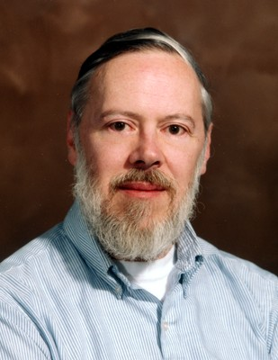
Computers, Programming and C (a programming language)
Kate Collins, Oscar O’Hara,
Sudarshan Narasimhan & James Kirwan

Slide 2

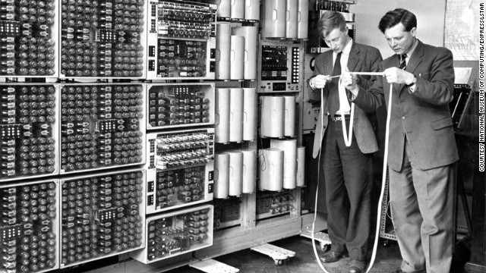
What is a Computer?
A computer is a programmable machine that can perform arithmetic or logical operations.
“An electronic device that is capable of receiving information (data) in a particular form and of performing a sequence of operations in accordance with a predetermined, but variable set of procedural instructions (program) to produce a result in the form of information or signals.”
Notes:
“What is a computer?” quote - sourced from Google.

Slide 3
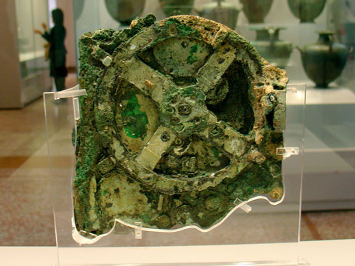
History of Computers
The oldest known computer is the Antikythera Mechanism (~150BCE), which was used for astronomical calculations.
Since about 1940, modern computers have advanced exponentially. Moore’s Law on the matter states that every 18 months, computers double in ‘speed’ (overall performance) and halve in price.
The most notable advancements in the development of the computer include Charles Babbage’s Analytical Engine, the development of silicon microprocessors (Intel) and the integration of electronic circuit components into computers (notably the transistor, ~1947).

Slide 4
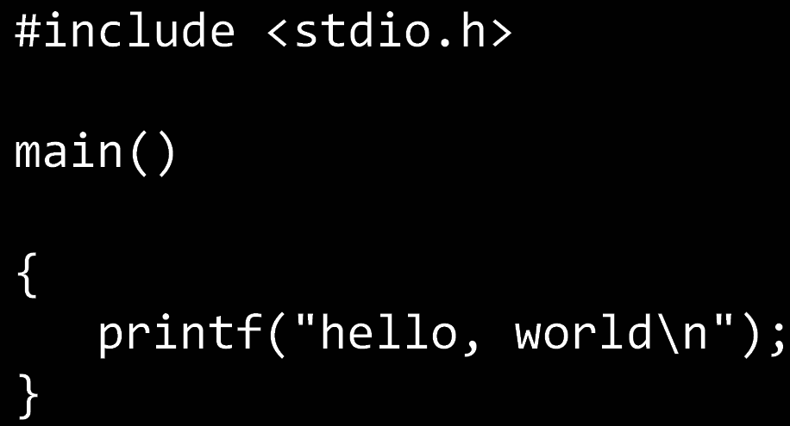
What is a Computer Programme?
A computer programme is a set of instructions for a computer to follow.
These programmes come in different languages. These programming languages include HTML, C, Java, Ruby
and Python.

Slide 5
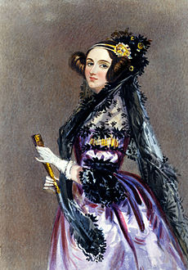
History of Programming
ADA LOVELACE AKA QUEEN
Ada was the world’s first computer programmer.
She was the first person to write an algorithm that was meant to be processed by a machine. She wrote the algorithm for Charles Babbage’s machine.
She realised that computers could be used for more than just calculations.
Ada was born in 1815 and died in 1852 aged just 36.
For some reason no one knows about her.
You wish you were as cool as her. Don’t deny it.
Notes:
http://en.wikipedia.org/wiki/Ada_Lovelace

Slide 6
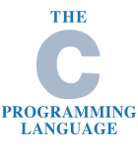
Who Developed C?
C was developed by American computer scientist Dennis Ritchie in 1972.
Ritchie worked with Bell Labs, a research and development subsidiary of Alcatel-Lucent, during the development of this programming language.
Ritchie is also known for the development of the Unix OS alongside Ken Thompson.
Many future programming languages have borrowed from C, eg. C++, Java, JavaScript, Python, PHP, Limbo, C#, and many more widely used coding languages.
Notes:
http://en.wikipedia.org/wiki/C_%28programming_language%29

Slide 7
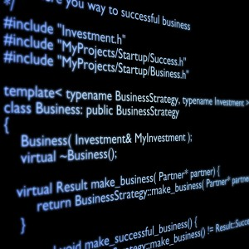
Where is C used?
C is often used for system programing such as implementing systems and embedded systems.
Widely use to implement end user applications.
Website programing using CGI as a "gateway" for information between the Web application, the server, and the browser.
C allows quick and effective implementation of algorithms and data structure which is useful for programs that perform a lot of computations.
Notes:
http://en.wikipedia.org/wiki/C_%28programming_language%29#Uses

